Slide 1

Deus Ex bach-ina
Generating music in the style of the Well-Tempered Clavier
Notes:
Welcome to Deus Ex Bach-ina! I taught a Recurrent Neural Network built with Tensorflow to create new sequences of notes using the style of Bach’s Well-Tempered Clavier as the training input.

Slide 2
Contents
Historical background
Software
Theory
Other notes

Slide 3

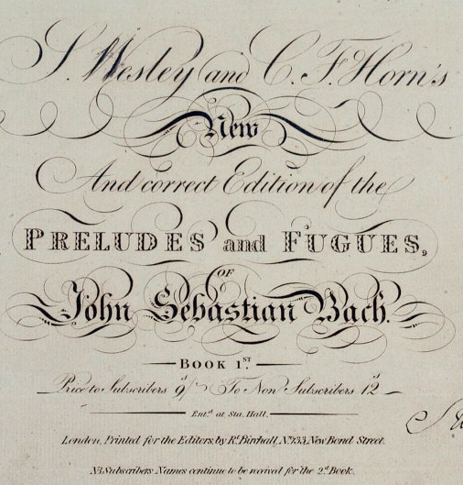
The Well-Tempered Clavier
Collection of 24 Preludes and Fugues
Covers every musical key, major and minor
Credited with popularizing equal temperament
This Photo by Unknown Author is licensed under CC BY-SA
Notes:
I opted for WTC because it covered the breadth of all key combinations in Western music, is a popular and broadly available collection, and has been heavily researched for its influence in keyboard music.

Slide 4
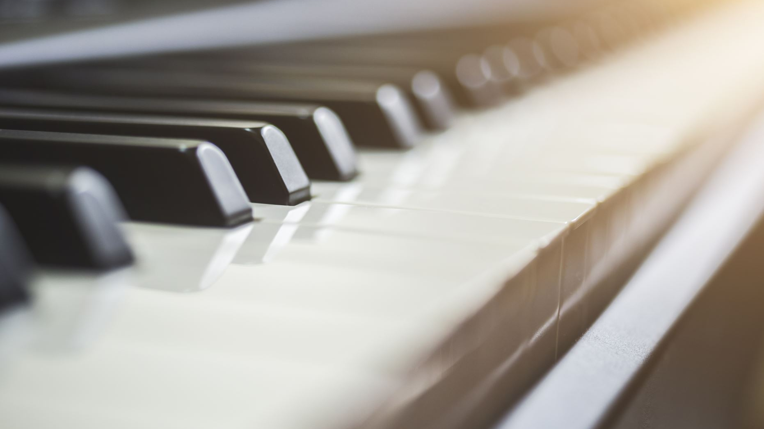

Musical Instrument Digital Interface
What is MIDI?
Digital representation of a musical performance
Standardizes and numericizes:
Instrument played
Pitch
Dynamics
Keyboard instruments make for good ‘on/off’ signals
Notes:
With MIDI, the audio data is no longer represented by a sin frequency but a single absolute value, i.e. A could be 31, 43, 55, etc.
Makes it easier to feed into a machine – it’s already a numerical representation
How to handle notes appearing together or separately, silence(?!), what happens with key changes

Slide 5
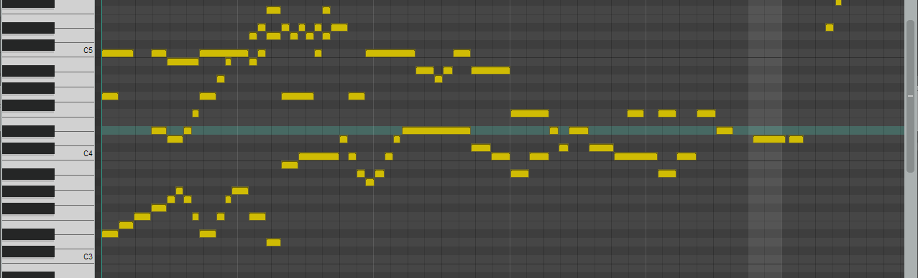
Processing the Data
Using PyPianoRoll, convert to NumPy array
The MIDI does not maintain tempo or dynamics
The keys are ‘on/off’ values, so always 88 values of 0 or 1

Slide 6
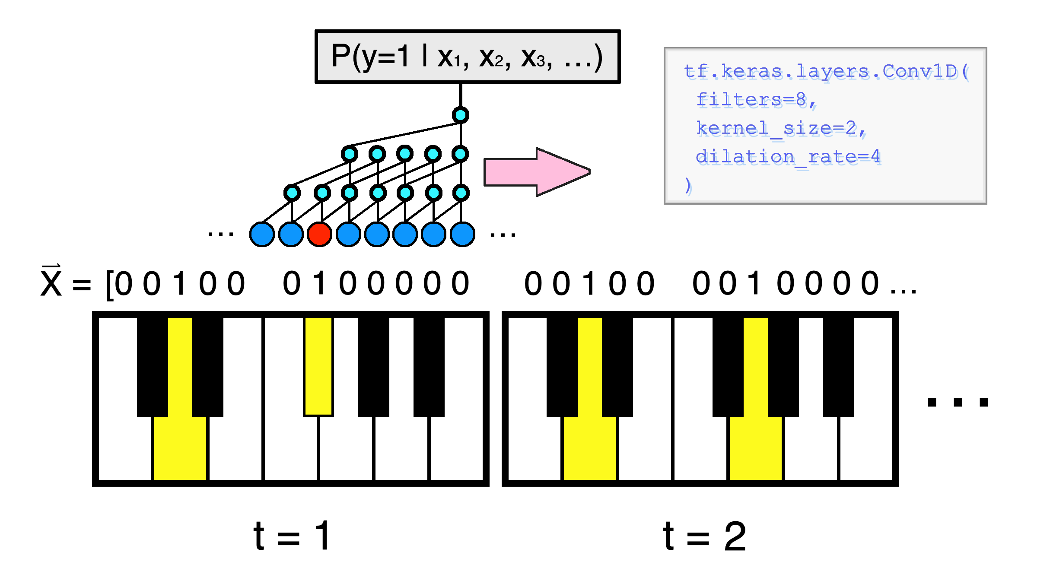
The Model
WaveNet-based Recurrent Neural Network
Predict the subsequent note given one to start on
As note sequences, intervals are respected
Notes:
As the model receives input, it estimates the subsequent note and measures its distance from the true note in the composition.
The idea is that the model could be close enough to a human that it could estimate a note correctly enough to build off itself

Slide 7

Training The model
33 Convolutional Layers of increasing Dilation Rate
Trained for ~1600 Epochs
Measured loss – Binary Crossentropy
Notes:
Findings

Slide 8
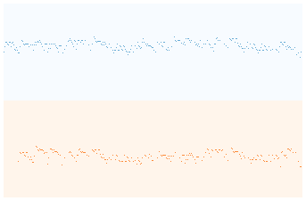

The first Performance (100 Epochs)

Slide 9

Performance after 1600 Epochs
Notes:
Example Song

Slide 10
Future Development
-Online learning
-’Recover’ when the model loses direction
Notes:
While these would be novel additions to the model’s structure, the likely best addition is just to beef up the model, increasing its layer count and respective dilation rate while providing even greater amounts of time.
Changing the input more may have been more robust: rather than one movement per key, have every movement performed in every key to reduce chance that a sequence is learned by a particular key.

Slide 11
Thanks
Keras
Tensorflow
Pygame
Pypianoroll
Jupyter
Docker
Joblib
Special thanks to Medium author Thomas Angsten for outlining how to process MIDI with PyPianoRoll

